Slide 1


Slide 2
Immunogenicity and Antigens
Definitions:
Immunogen
Antigen
Hapten
Carrier
Hapten-Carrier = Immunogen
Hapten-Carrier in Basic Sciences (signaling / Activation …)
Hapten-Carrier in Clinical Sciences (CAD)

Slide 3
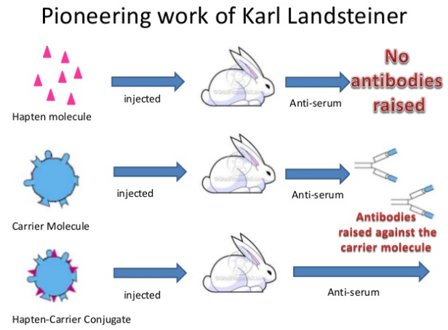
Immunogenicity and Antigens

Slide 4
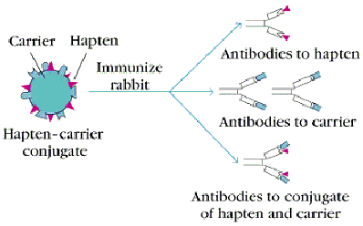
Immunogenicity and Antigens

Slide 5
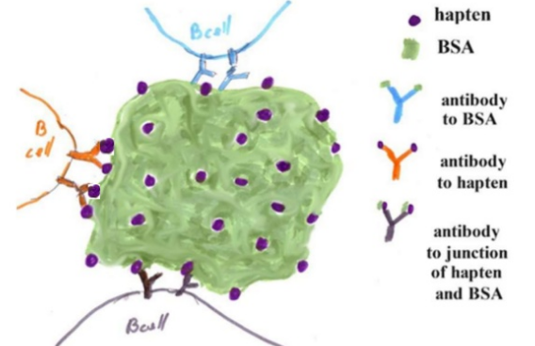
Immunogenicity and Antigens

Slide 6
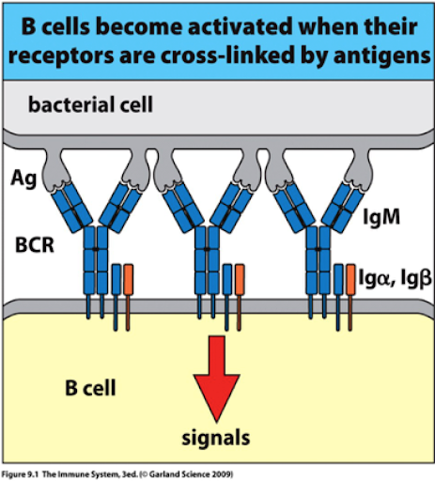
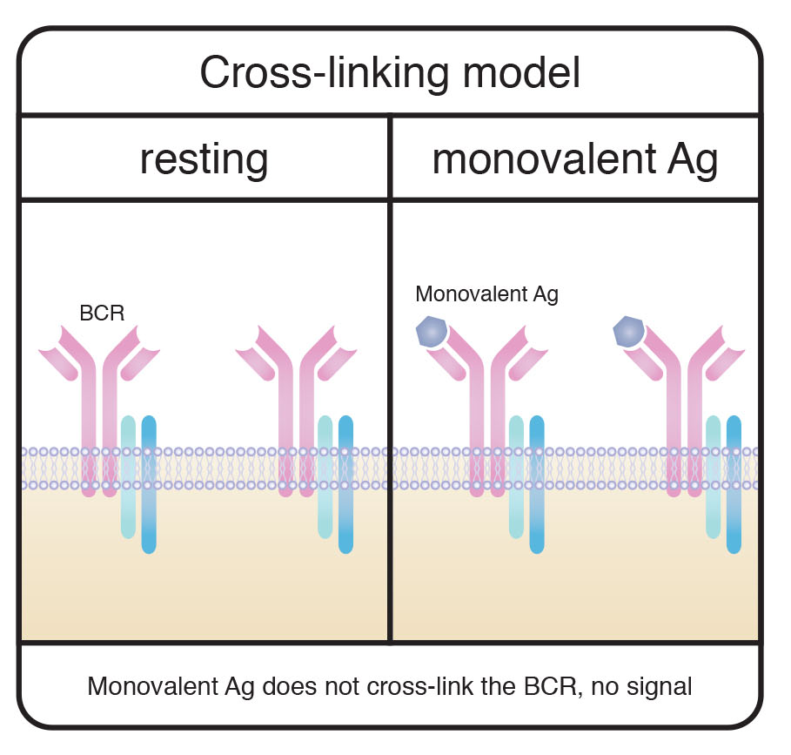
Immunogenicity and Antigens
Two signal hypothesis
BCR cross linkage
Co-stimulatory Signal

Slide 7
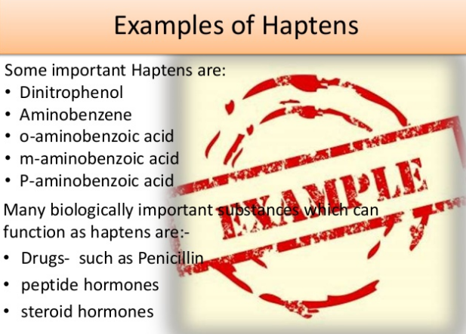

Slide 8
Immunogenicity and Antigens
Definitions:
Ag Determinant – Epitope
Ag Capacity
Epitope : monovalent / polyvalence = multivalence
Active Epitope / Hidden Epitope ……Immunodominancy
Epitope Immunogenicity …….5000 mU / 1 Epitope
Epitope selection ……………..Hydrophilicity / alienation
Epitope : Overlapping / non overlapping
Epitope : Allosteric Effects

Slide 9
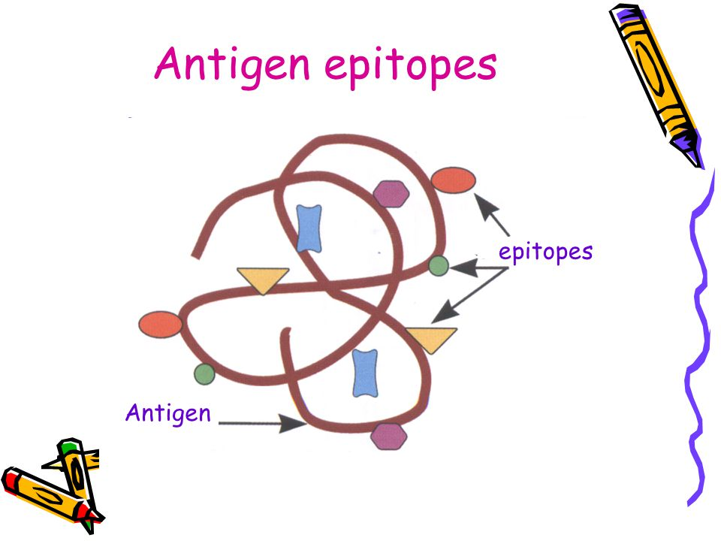
Immunogenicity and Antigens

Slide 10
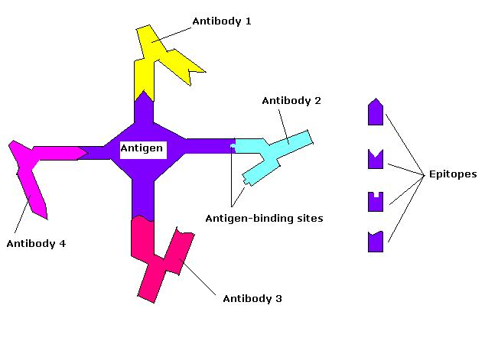
Immunogenicity and Antigens

Slide 11
Immunogenicity and Antigens
Epitope Classification :
1) Linear (sequential) Epitope : Accessible / Inaccessible
2) Space ( Structural) (Conformational) Epitope
3) Neo antigenic (New determinant) Epitope

Slide 12
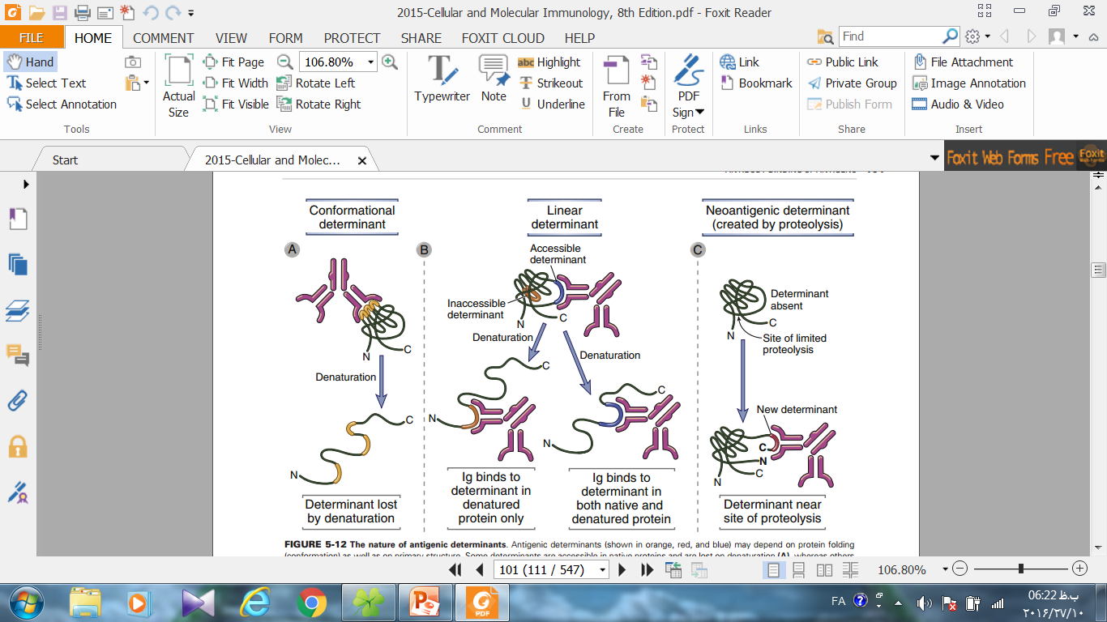
Epitope Classification :
1) Linear (sequential) Epitope : Accessible / Inaccessible

Slide 13
Epitope Classification :
2) Space ( Structural) (Conformational) Epitope

Slide 14
Epitope Classification :
3) Neoantigenic (New determinant) Epitope

Slide 15
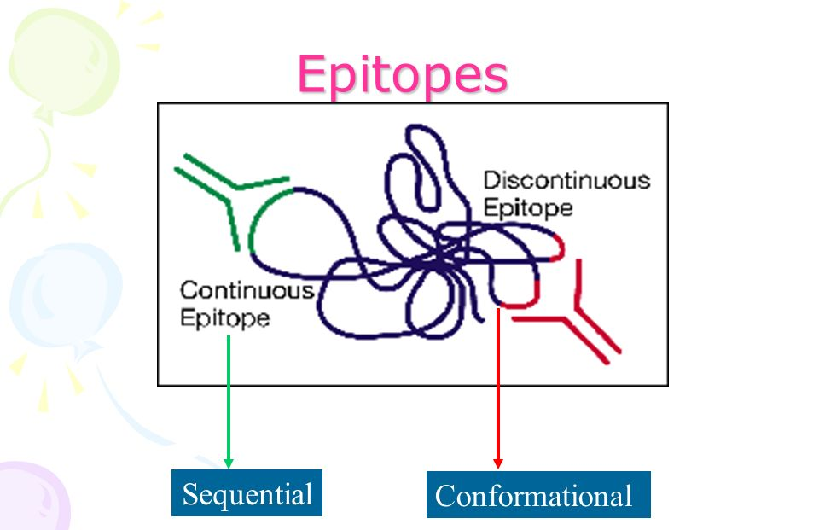
Immunogenicity and Antigens
Epitope Classification :
Continuous Epitope
Discontinuous Epitope

Slide 16
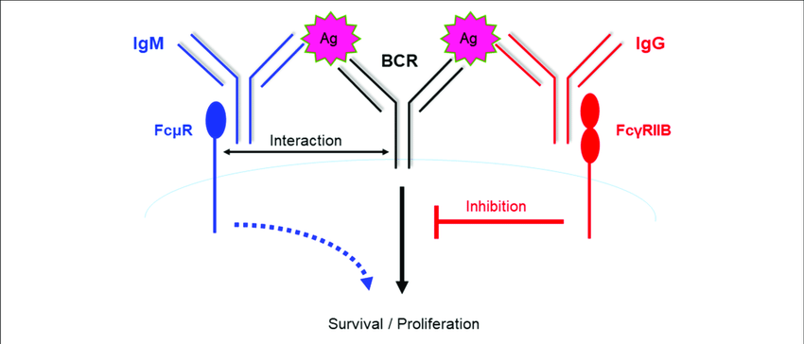
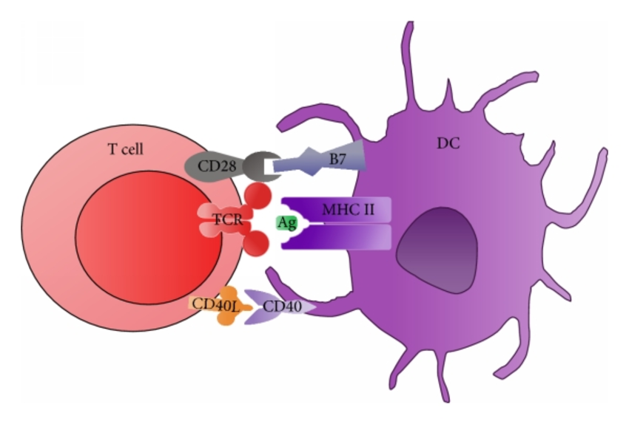
Immunogenicity and Antigens
Epitope Classification :
Haptenic Epitope………….BCR / Ab
Immunogenic Epitope …….TCR

Slide 17
Effective Parameters in immunogenicity
Alienation (self non-self discrimination): sperm, mitochondria, coronae
Molecular Size : (10000 D) / HC=6,700,000/ Alb=60,000 / AT=1031
Complexity : (homo polymer/co polymer) / Aromatic AA
Degradability : Structural Stability :
Administration of Ag : (IV) – (SC / ID / IM / IP )
Genetic Makeup: Ps-Ag ( Human & mouce)+ (Rabbit & GP)-
Leishmania (C57 / H2-b): R………… ( Balb/C / H2-d): S

Slide 18
Effective properties of The host in immunogenicity
Age
Genetic Makeup
Dietary
Exercise
Stress
Sexuality

Slide 19
Immunogenicity and Antigens
Cross Reaction :
Blood group Ab ( heterophyle Ab)
Weil-Felix reaction ( proteous vulgaris OX19 / rickettsia typhi)
Adjuvants:
increase of survival time of immunogenic material
increase of MФ and Lymphocyte stimulation
increase of immunogenic to MФ attachment (Effective Size)
CFA , IFA , ALUM , …..(Al. phosphate / Al,K. sulfate, Be. sulfate)

Slide 20
Antigenic (Stimulators) Classification
based on type of response:
Immunogen
Tolergen (Tolerance / Immunological unresponsiveness)
Allergen (Hypersensitivity):IgE /
low MW / Stability / Glycosylation / Solubility

Slide 21
Antigenic (Stimulators) Classification
B. based on type of recognition and presentation: (severity)
Classical Ag : [99% / two signal / (1/100-1/1000) B & T cells]
Super Ag: [2-20% / α1 (MHCII) - CDR4 (βTCR)/ CK secretion
(IL-2 , IFN-γ , TNF-α) / Apoptosis )
3) Mitogen: [30-70% / non-specific & polyclonal ]
pwg (B&T) / PHA(T) / Con-A(T)

Slide 22
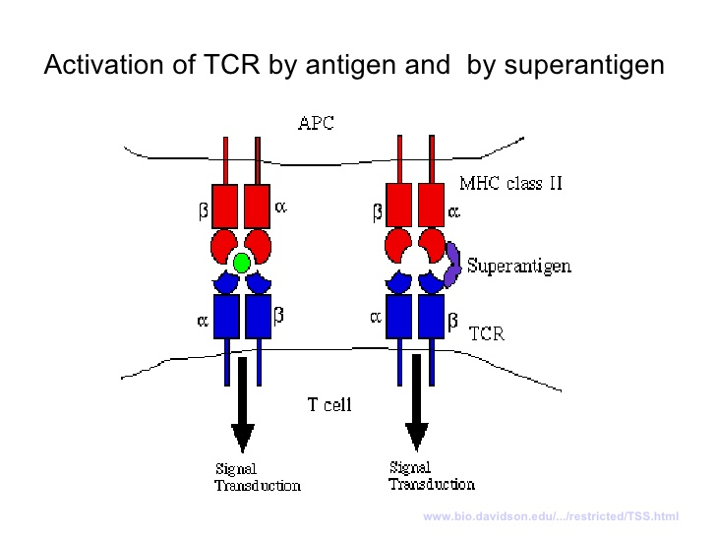

Slide 23
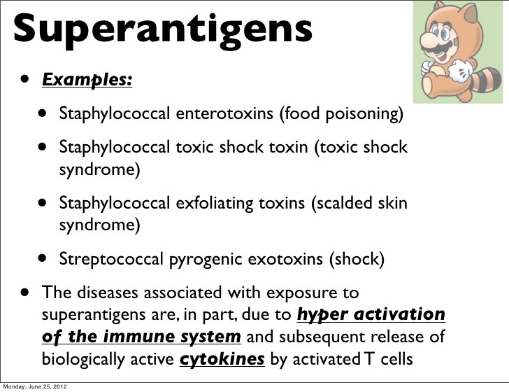

Slide 24
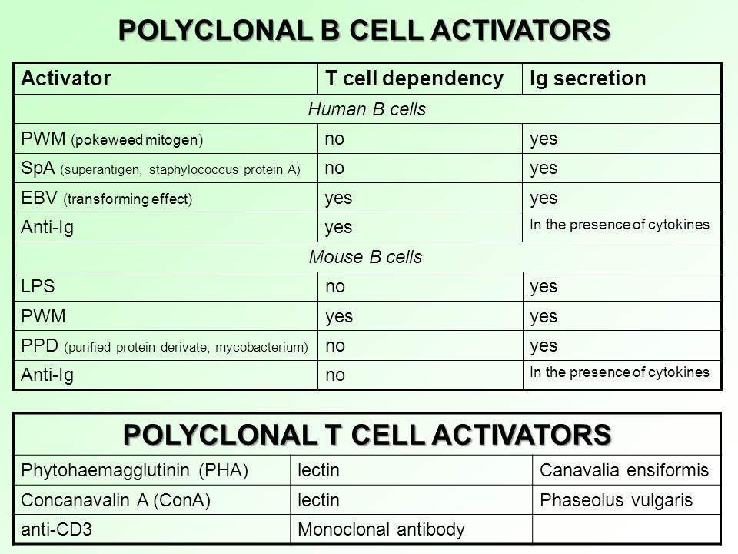

Slide 25
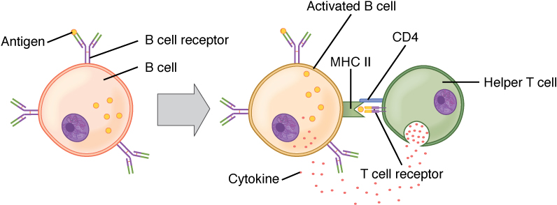
Antigenic (Stimulators) Classification
based on T-cell dependency:
TD = T cell dependent / pro. Ag (two signal)
Ti = T cell independent / bacterial PS / polymer proteins

Slide 26
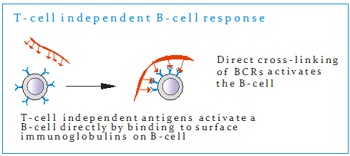
based on T-cell dependency:
TD = T cell dependent / pro. Ag (two signal)
Ti = T cell independent / bacterial PS / polymer proteins

Slide 27
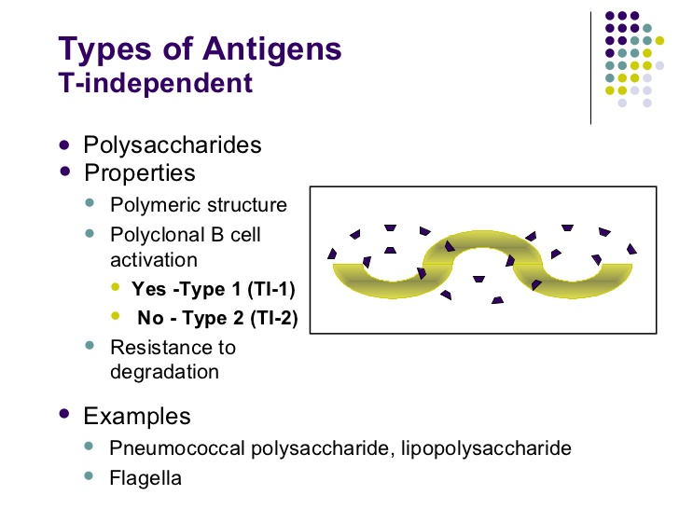

Slide 28
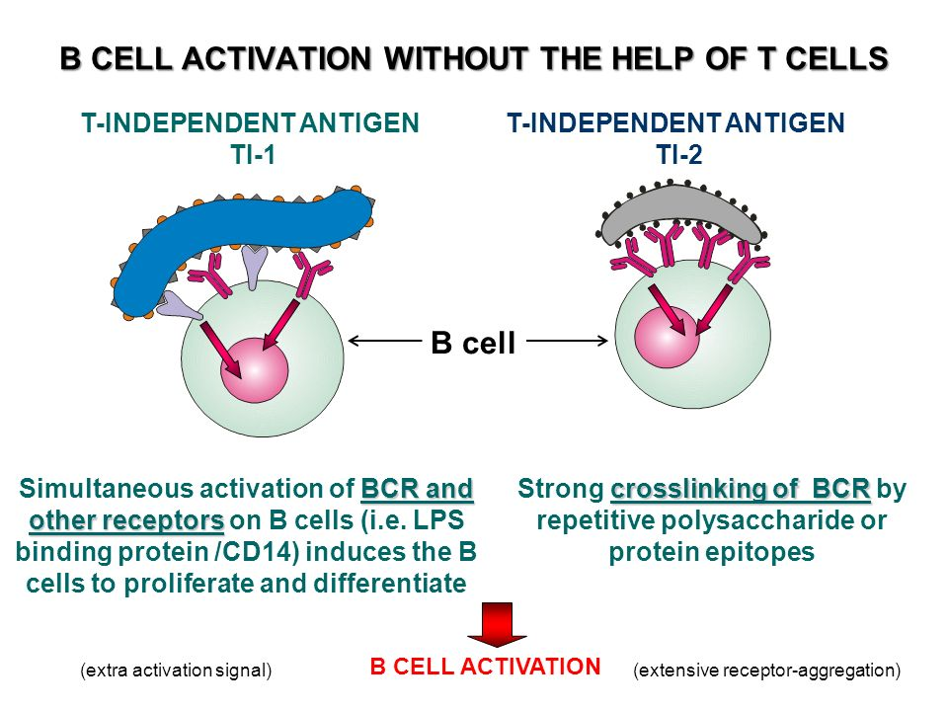

Slide 29
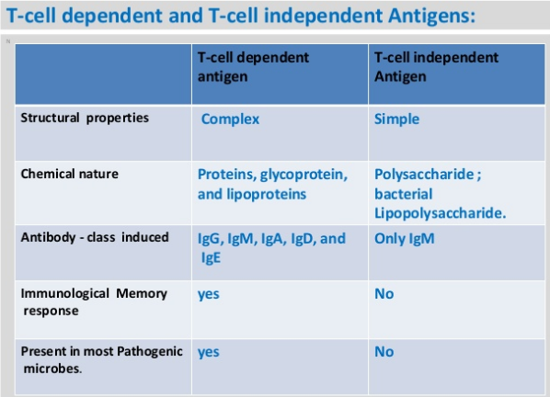
T-efficient

Slide 30
Antigenic (Stimulators) Classification
D) based on Structure:
Proteins: (Toxins, flagella, Viral Capsids, serum pro., Ab, MHC,…)
Polysaccharides: (negative gram bacteria, BGA)
Lipids: ….( lipoproteins)
Nucleic Acid: …….(nucleoprotein)….. SLE

Slide 31
Antigenic (Stimulators) Classification
E) Based on species relational with hosts :
Auto-Ag ( Self-Ag)
Allo-Ag (Iso-Ag)…BGA
Hetero-Ag
Xeno-Ag
Heterophilic-Ag …Forsman Ag

Slide 32
Antigenic (Stimulators) Classification
Based on response origin:
Homologous-Ag
Heterologous-Ag

Slide 33
Some of Antigenic groups
Bacterial Ag : (Cell wall, Capsule, flagella, pili)
O-Ag K-Ag H-Ag F-Ag
( Endotoxin / Exotoxin…….Toxoid)
Viral Ag: ( capsid, capsomer, envelope )
Cell surface Ag: ( BGA , MHC )
Auto Ag : ( thyroglobulin, BM, myelin, mitochondrial, …)

Slide 34

از حضور وتوجه شما
سپاسگزارم

