Slide 1


Slide 2
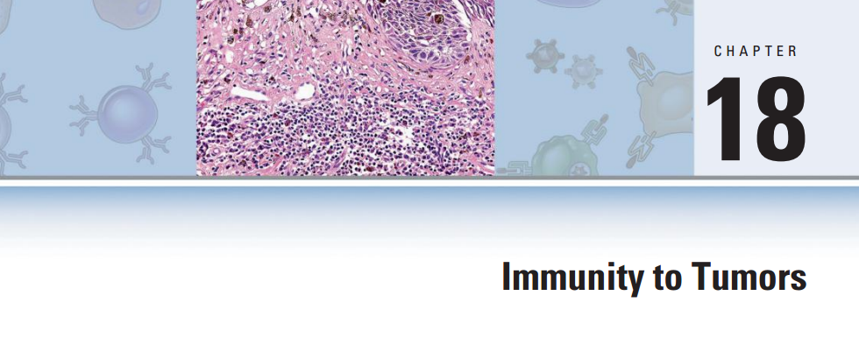
Immunity to Tumors
Dr : morteza Hosseinzadeh
Ilam University of Medical Sciences

Slide 3
Tumor Immunology
Definition:
Cells that continue to replicate, fail to differentiate into
specialized cells, and become immortal.
Malignant: tumor that grows indefinitely and spreads
(metastasis)- also called cancer: (kills host)
Benign: tumor that is not capable of metastasis: (does not kill host)

Slide 4
Tumor Immunology
Malignancy:
defects in regulation of cell proliferation,
resistance to apoptotic death,
ability to invade host tissues
metastasize to distant sites,
tumor evasion of host immune defense mechanisms
Immune Surveillance
Macfarlane Burnet ( 1950)

Slide 5
Etiology of Tumor / Cancer
Genetic factors:
mutations, translocation, amplifications,…….
Environmental factors:
UV, chemicals, viral infections,………..
Conversion of proto-oncogenes to oncogenes (potential for cell transformation)
Alteration In Tumor Suppressor Genes (TSG)

Slide 6
Types of Tumor / Cancer
Carcinoma: arising from Ectoderm / epithelial tissue, such as glands, breast, skin, and linings of the urogenital, digestive, and respiratory systems (89.3% of all cancers)
Sarcoma: solid tumors of muscles, bone, and cartilage that arise from the embryological mesoderm (1.9% of all cancers)
Leukemia: disease of bone marrow causing excessive production of leukocytes (3.4% of all cancers)
Lymphoma, Myeloma: diseases of the lymph nodes and spleen that cause excessive production of lymphocytes (5.4% of cancers)

Slide 7
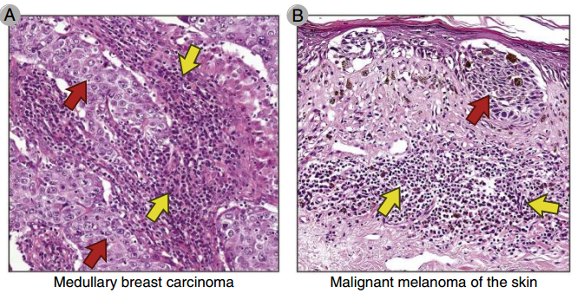
Overview of Tumor Immunity
Tumors stimulate specific adaptive immune responses
T Cell-(T CD8+)
NK Cell
mФ

Slide 8
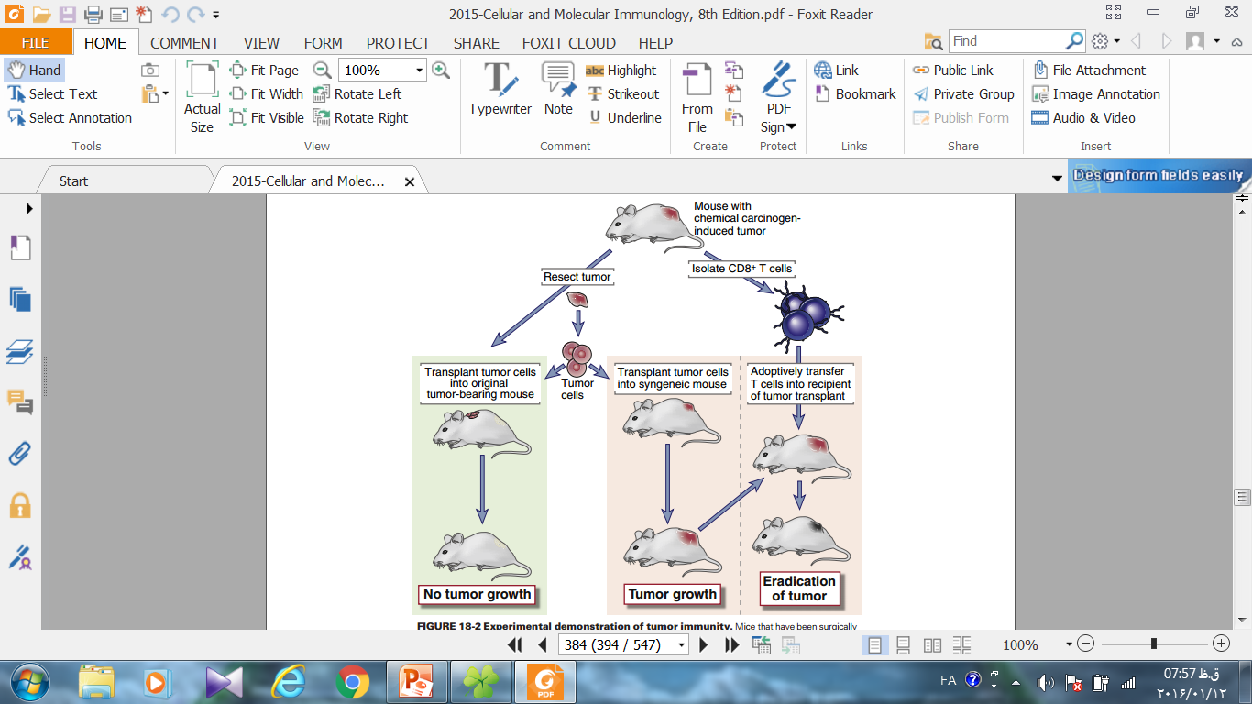
Overview of Tumor Immunity
MCA

Slide 9
Overview of Tumor Immunity
Immune responses frequently fail to prevent the growth
many tumors have specialized mechanisms for evading host
immune responses
tumor cells are derived from host cells and resemble normal.
the rapid growth and spread of a tumor may overwhelm the
capacity of the immune system response.
The immune system can be activated to effectively kill tumor cells and eradicate tumors. (tumor immunotherapy)

Slide 10
Tumor Antigen
Based on patterns of expression:
Tumor-specific antigen (TSA) – ( unique / Common)
Tumor-associated antigen (TAA) – (normal cellular constituents)
2) Based on molecular structure and source of the antigen:
Tumor Antigens Recognized By (CTLs) CD8+
Tumor Antigens Recognized By Antibody (Ab)

Slide 11
1) Products of Mutated Genes (Neoantigen)
Randomly Mutated Genes (Passenger mutation)
Mutated protooncogenes (Oncogene)- Ras -Bcr/Abl
Mutated tumor suppressor gene (mTSG) – P53
Tumor antigens may be produced by randomly mutated genes
whose products are not related to the malignant phenotype:
(TSTA) (different transplantation antigens)

Slide 12
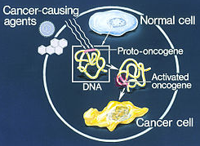

Slide 13
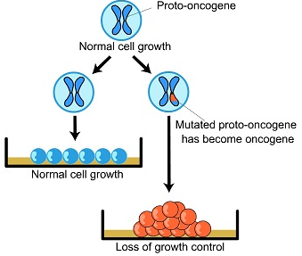

Slide 14
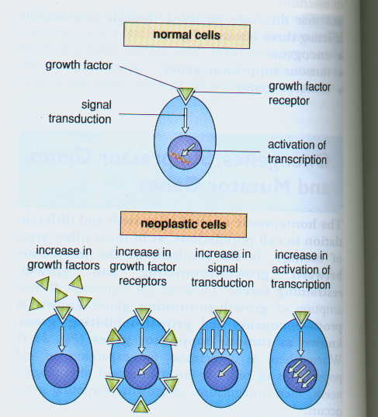
Four mechanisms of oncogene activity to deregulate cell division

Slide 15
Oncogenesis
carcinogen
results in mutation
increased GF
increased GF receptors
proto-oncogenes
oncogenes
exaggerated
response to GF
Tumor Suppressor genes
dysfunctional
tumor suppressor
genes
loss of ability to
repair damaged
cells or induce
apoptosis
inherited
defect

Slide 16
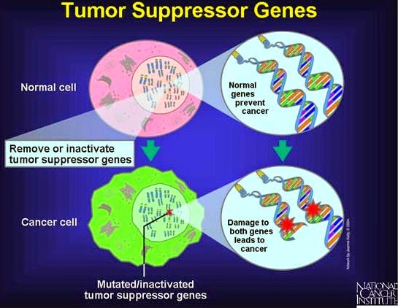

Slide 17
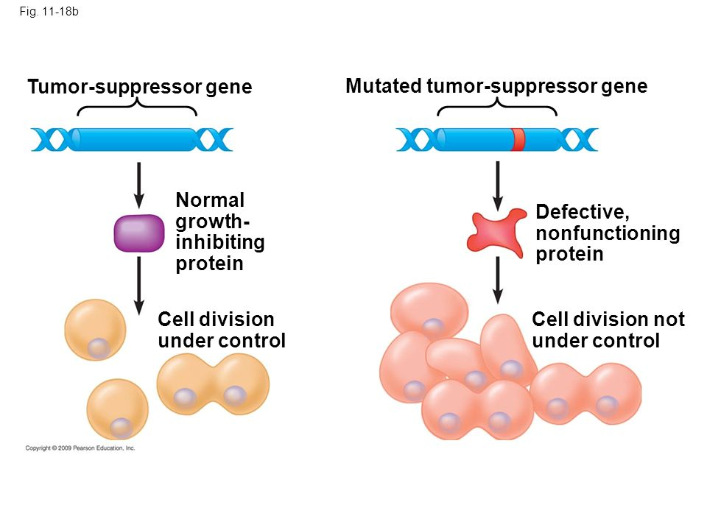

Slide 18
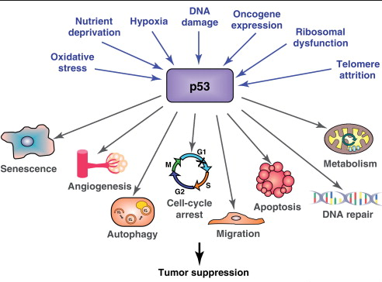

Slide 19
2) Abnormally Expressed but Unmutated
Cellular Proteins
1) Cancer/testis antigens ……. ( normal: gametes and trophoblasts)
( many types of cancers)
( but, its not in normal somatic tissues)
MAGE proteins …(melanoma, bladder, breast, skin, lung, prostate, sarcomas) (BAGE & GAGE) (recognized by CTL clones) (50% in X chromosome)
(Silent Genes) (not required for the malignant phenotype)
2) HER2/Neu …… (breast Cancer and other carcinomas)
(human epidermal growth factor receptor 2)

Slide 20
2) Abnormally Expressed but Unmutated
Cellular Proteins
3) normal cellular proteins.....(abnormally expressed in tumor cells)
Tyrosinase, …… ( melanin biosynthesis)……(melanocytes / melanoma)
MART-1, (Melan-A)………(melanosome function)
(T CD8+ , T CD4+ )…(fails to induce tolerance)…(Vaccine)
gp100

Slide 21
3) Antigens of Oncogenic Viruses
products of oncogenic viruses …(CTLs)….eradicate the tumors
DNA Viruses: (Human , Ex. Animals)
EBV:……….. B cell lymphomas and nasopharyngeal carcinoma
HPV:…..……uterine cervix carcinomas,
KSHV/( HHV-8)……………….…. vascular tumors
Papovaviruses ( polyomavirus & SV40)……Adenoviruses malignant tumors…..(neonatal or immunodeficient adult rodents)
MHC-I ………….( immunogenic tumors )
Suppressed Adaptive Immunity (AIDS) ……. Tumors
Oncogenic Viruses Vaccines: (HPV) & (HBV)

Slide 22
3) Antigens of Oncogenic Viruses
products of oncogenic viruses …(CTLs)….eradicate the tumors
DNA Viruses: (Human , Ex. Animals)
RNA Viruses (retroviruses): ( Animal)
(HTLV-1): ( human T cell lymphotropic virus 1)
(ATL): (Adult T Cell Leukemia/Lymphoma) : T CD4+

Slide 23
4) Oncofetal Antigens (TAA)
proteins that are expressed:
normal developing fetal
high levels in cancer cells
not adult tissues
Identified With other Species Antibody
Tumor Diagnosis Marker
Found In Small Quantities In Normal Tissue

Slide 24
4) Oncofetal Antigens (TAA)
CEA (CD66): ( Carcinoembryonic Antigen) (180 Kd)
Glycosylated Membrane Protein / (Ig) Superfamily / Adhesion Molecule
High normally expression ( gut, pancreas, liver during the gestation,
low expression ( adult colonic mucosa and the lactating breast)
High expression:( carcinomas of the colon, pancreas, stomach, breast)
CEA serum level : ( to monitor situation of the tumors after treatment)
Chronic Inflammatory Conditions of the Intestine or Liver

Slide 25
4) Oncofetal Antigens (TAA)
AFP: ( α-fetoprotein)
circulating glycoprotein ( 70 Kd)
secreted in fetal life by the yolk sac and fetal liver.
concentrations ( 2 to 3 mg/mL)
replaced by albumin in adult life
elevated in patients with hepatocellular carcinoma, germ cell
tumors, gastric and pancreatic cancers.
indicator of liver or germ cell tumors after treatment
elevated levels in non-neoplastic diseases, liver cirrhosis

Slide 26
5) Altered Glycolipid and Glycoprotein Antigens (TAA)
Most human and Ex. Animal tumors,(diagnostic & targets for therapy)
( Recognized by Ab )
Gangliosides:
Mucins
blood group Ag
GM2, GD2, GD3:
neuroblastomas, melanomas, sarcomas
targets for therapy
targets for Vaccination
CA-125 , CA-19-9 …….(ovarian carcinomas)
MUC-1…………( breast and colon carcinomas )
……….…(recognized by mouse monoclonal antibodies)

Slide 27
6) Tissue-Specific Differentiation Antigens (TAA)
expressed only on the cells of origin of the tumors:
Particular Lineages , Differentiation Stages
( immunotherapy , identification of origin of tumors )
Normal self molecules,…….. ( No Immune response )
Melanoma ……… ( Tyrosinase ) CTL recognized
Lymphoma………..( CD10) …( CALLA) – pre B Cells
…...…..( CD20)
Non-Hodgkin’s B cell lymphomas ( anti-CD20 antibody)
(Rituximab)

Slide 28
Immune Responses To Tumors
Innate & Adaptive Immunity :
T lymphocytes ( T CD8+ , T CD4+ )
Natural Killer (NK) Cells
Macrophages
Antibodies

Slide 29
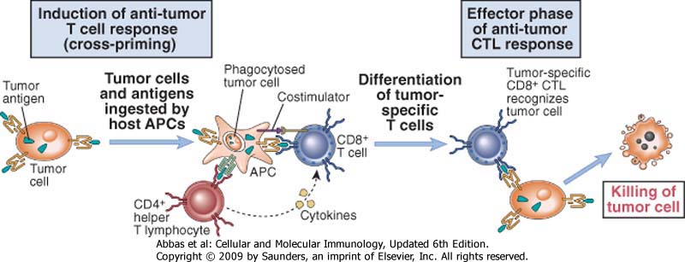
Immune Responses to Tumors
1) T lymphocytes ( CD8+)
Tils: Tumor-infiltrating
Lymphocytes
Th1
TNF & IFN-γ….(MHC-II) , mФ Activation
The killing of tumor
cells by CD8+ CTL
Antigenic pulsed APCs
vaccines to stimulate anti-tumor T cell responses

Slide 30
Tumor antigen or tumor cell
MAC
Perforins, apoptotic signals
T cytotoxic
memory cells
T cytotoxic cell
APC
MHC-I
T cytotoxic
effector cells
MHC II
IL-1
Interferon
T helper Memory cell
T helper cell-I
IL-2
Perforins, apoptotic signals
T helper Effectorcell
Cancer Cell
T cytotoxic cell
T helper cell-2
Generally ineffective tumor response, but some ADCC
IL-4
IL-5
Endogenous antigen
B Cell
Eosinophil

Slide 31
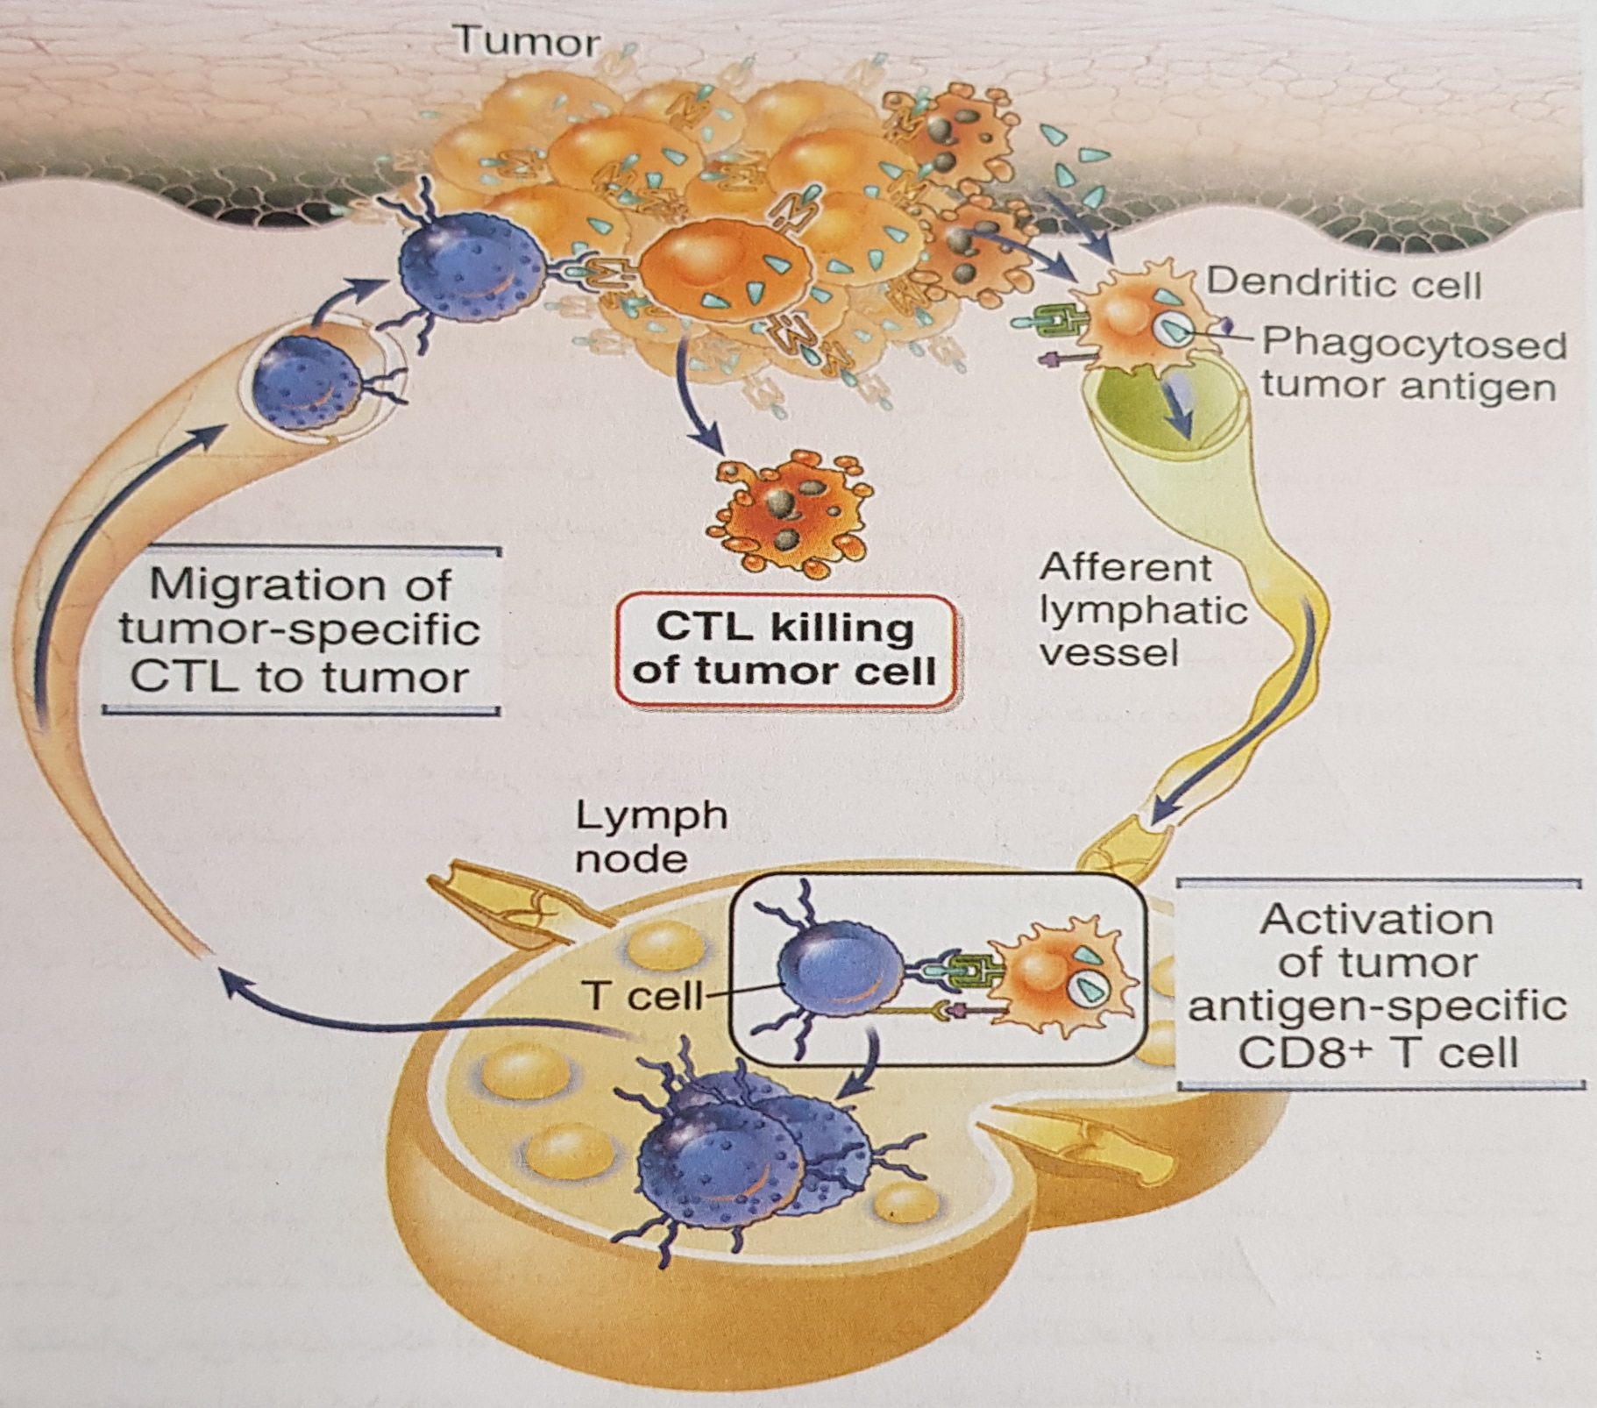
Immune Responses to Tumors
1) T lymphocytes ( CD8+)

Slide 32
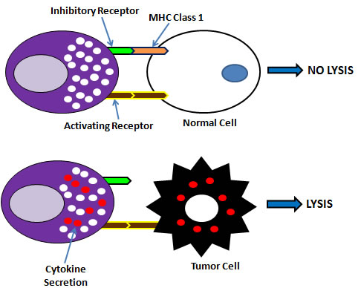
Immune Responses to Tumors
2) Natural Killer (NK) Cells
MIC-A, MIC-B, ULB
NKGD2

Slide 33
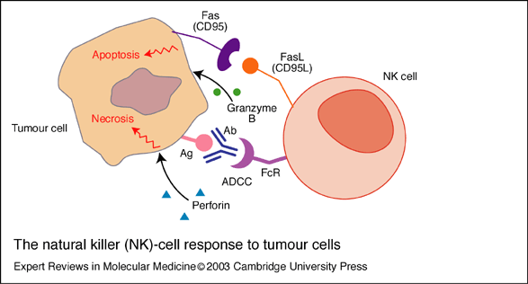
Immune Responses to Tumors
2) Natural Killer (NK) Cells
FCϒRIII (CD16)
NK Cell Activity:
IFN-γ , IL-12, IL-15
LAK-Cell:
NK Cell (IL-2)

Slide 34
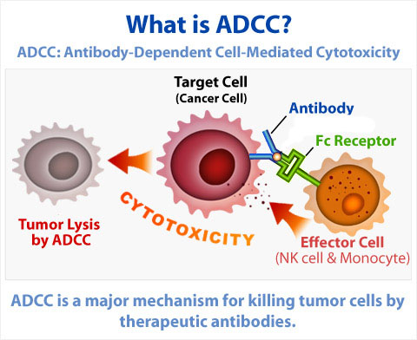
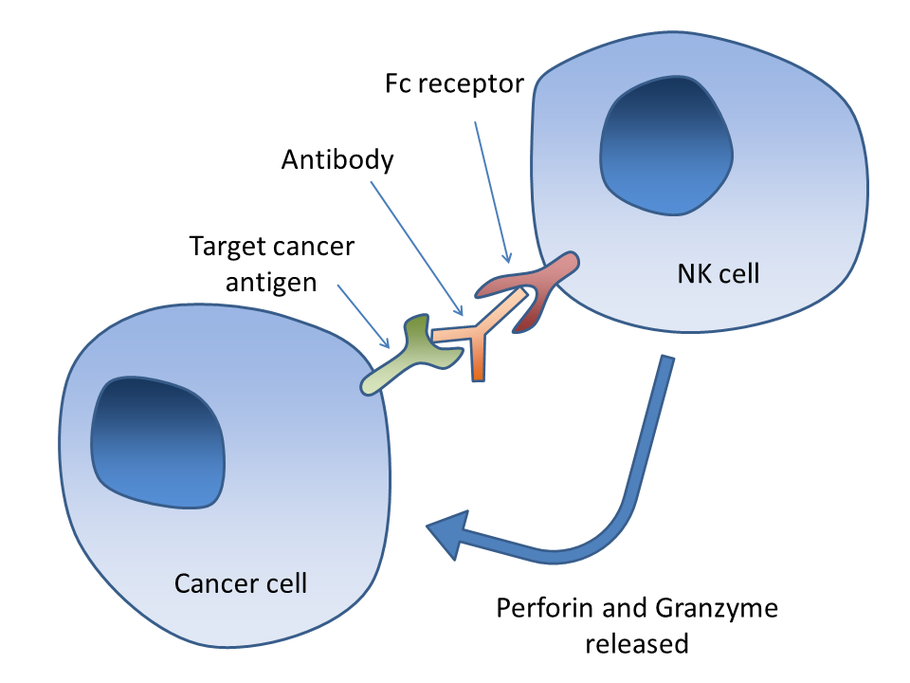
Immune Responses to Tumors
3) Antibodies
killing of tumor cells by activating complement or by ADCC

Slide 35
Immune Responses to Tumors
3) Antibodies

Slide 36
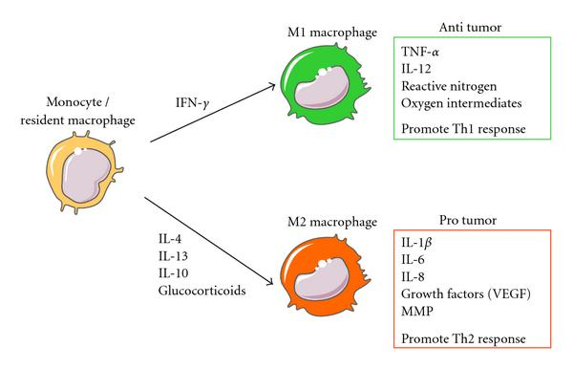
Immune Responses to Tumors
4) Macrophages
(NO)
(ROS)
Angiogenesis
TGF-β

Slide 37
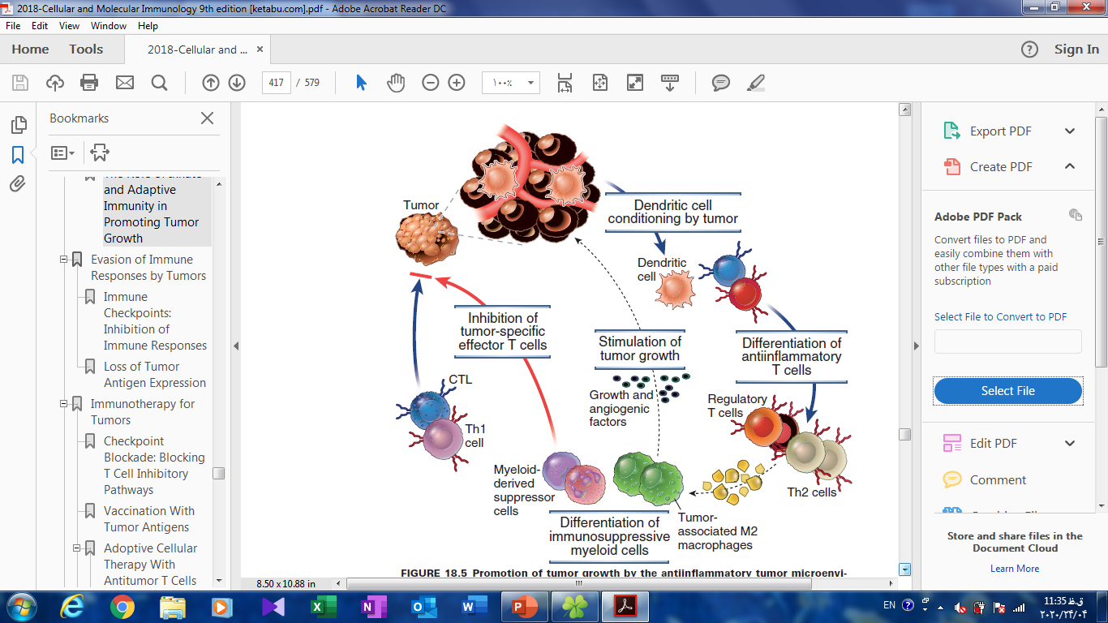
The Role of Innate and Adaptive Immunity in
Promoting Tumor Growth

Slide 38

از حضور و توجه شما
سپاسگزارم

