Slide 1


Slide 2
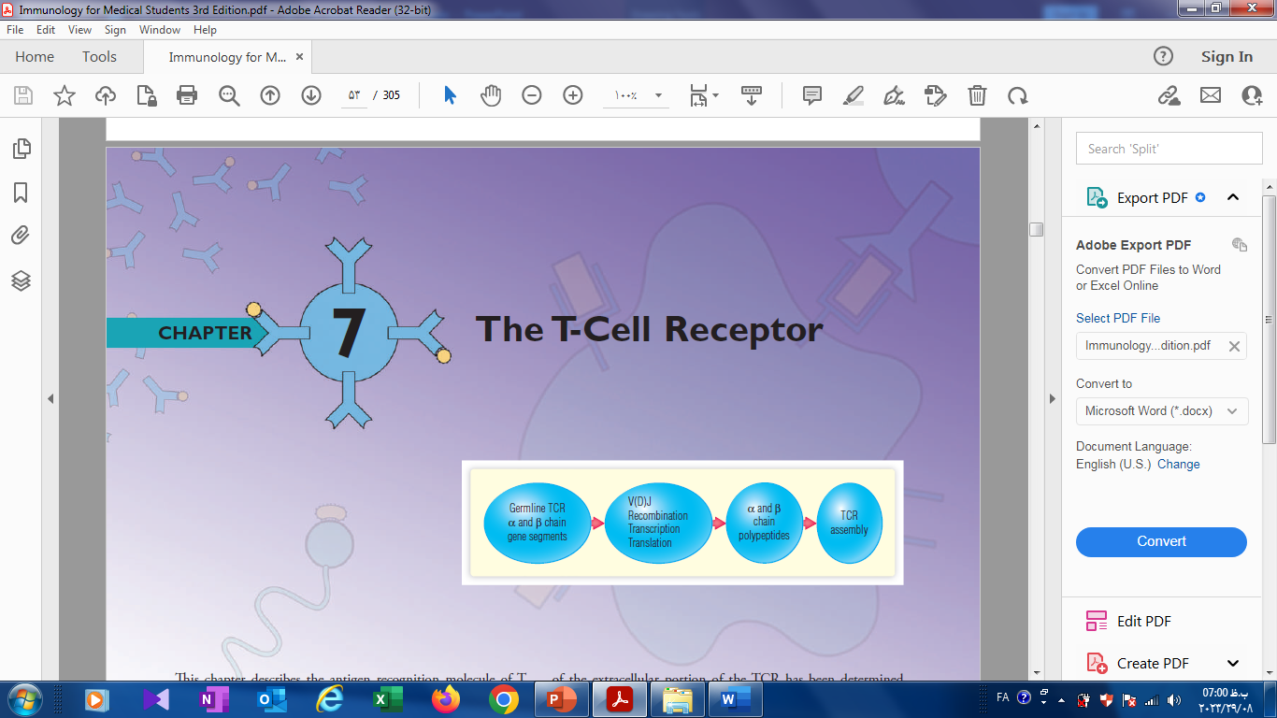
TCR : Genetic & Structure
Dr : morteza Hosseinzadeh
Ilam University of Medical Sciences

Slide 3
TCR : Genetic & Structure

Slide 4
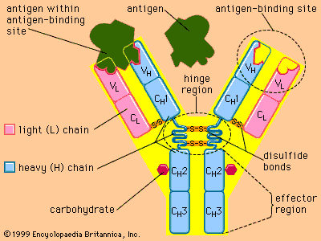

Slide 5
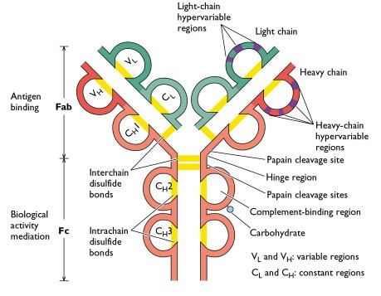

Slide 6
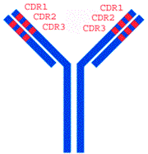

Slide 7
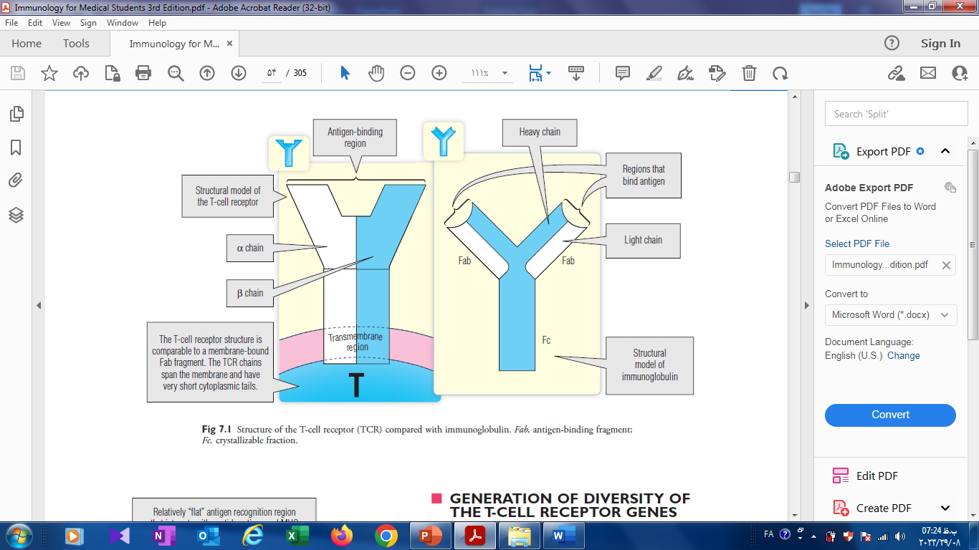
TCR : Genetic & Structure

Slide 8
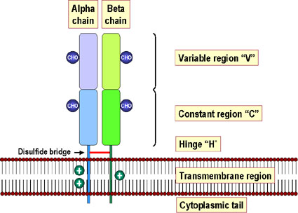
TCR : Genetic & Structure
95 %
Mr= 40,000- 60,000 D
Ag Binding Site
:sAgβV
Lys , Arg
lys
5-12 aa , short tail

Slide 9
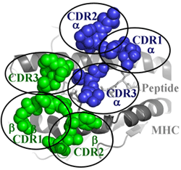

Slide 10
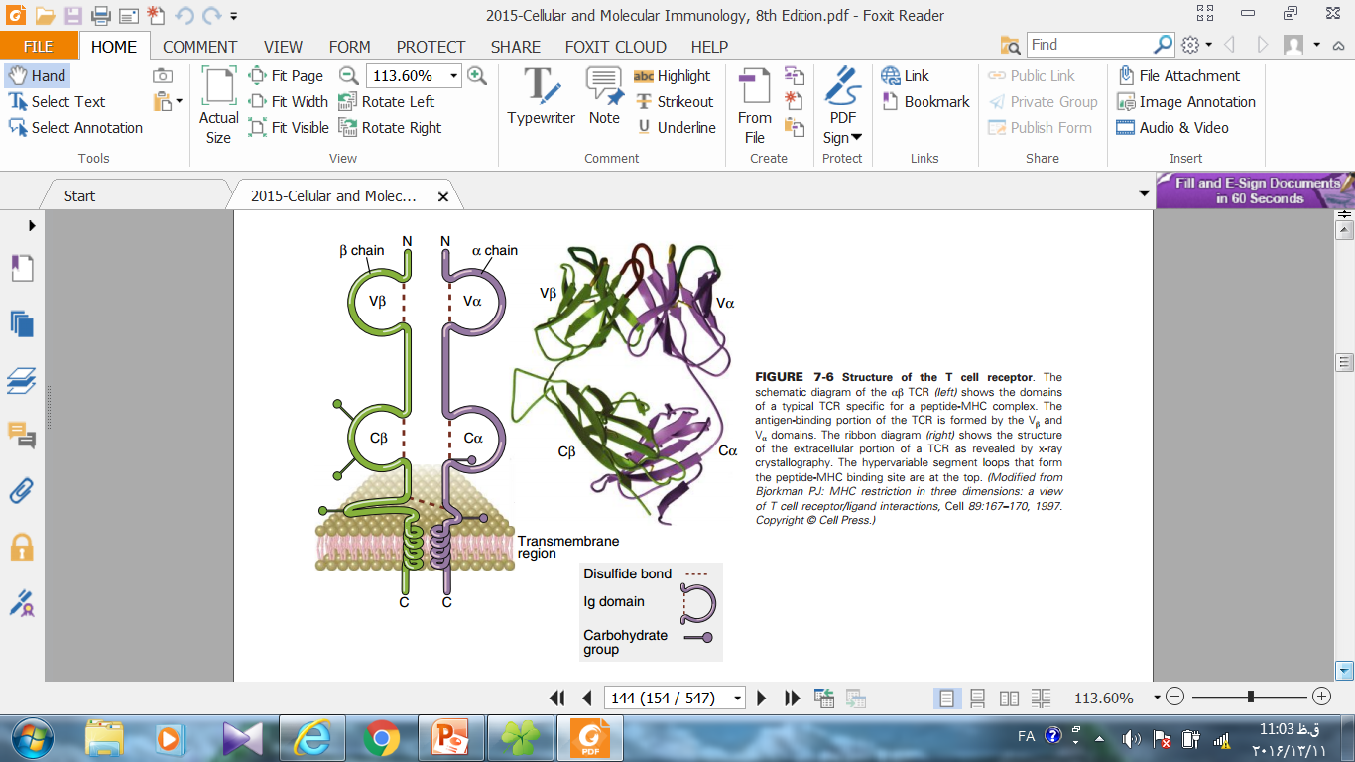
TCR : Genetic & Structure

Slide 11
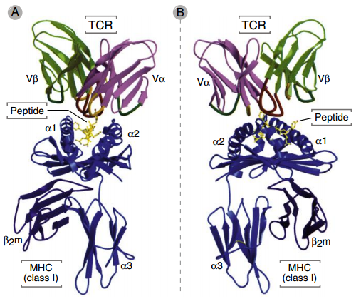
TCR : Genetic & Structure

Slide 12
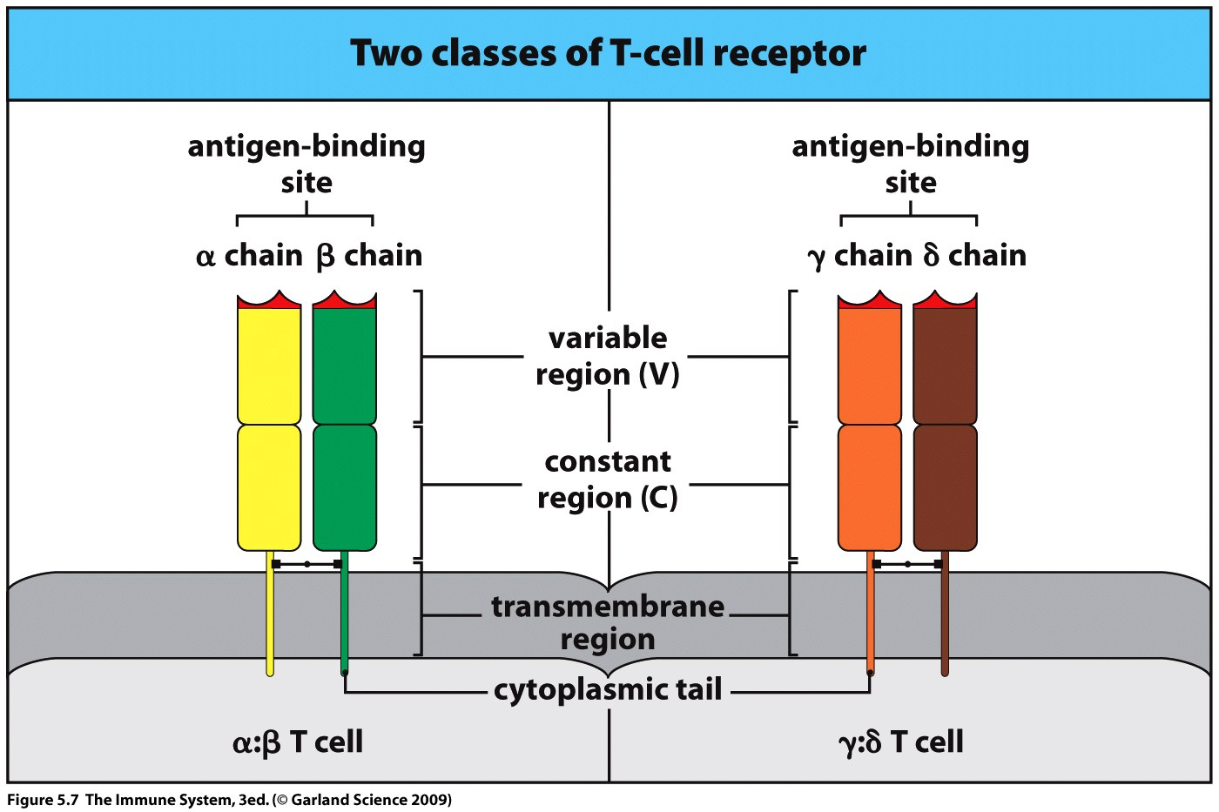
TCR : Genetic & Structure
95 %
5 %
TCR-2
TCR-1
Lipid recognition
MHC not restricted

Slide 13
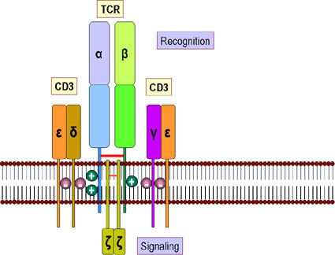
Other Accessory Molecules Involved In T-cell Function
Complex [TCR-CD3]
TCR-CD3 Complex
Ch : 11
Ig like Domain
Constant chain
Aspartic Acid

Slide 14
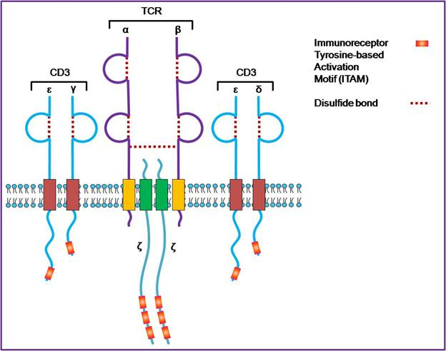
Complex [TCR-CD3]
ITAM: ARAM - 26 aa
9 aa
44-81 aa
113 aa

Slide 15
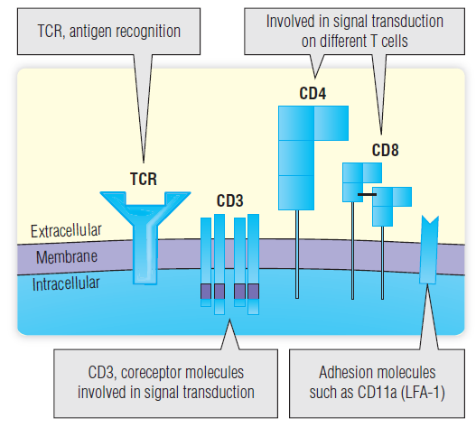
Complex [TCR-CD3]

Slide 16
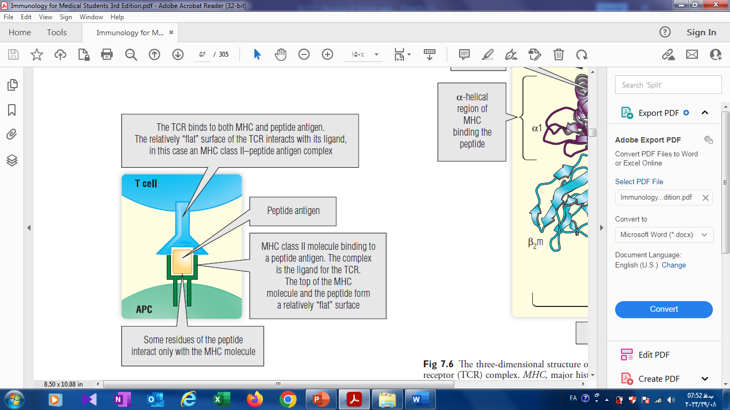
Interaction of the (TCR) with the peptide and (MHC)

Slide 17
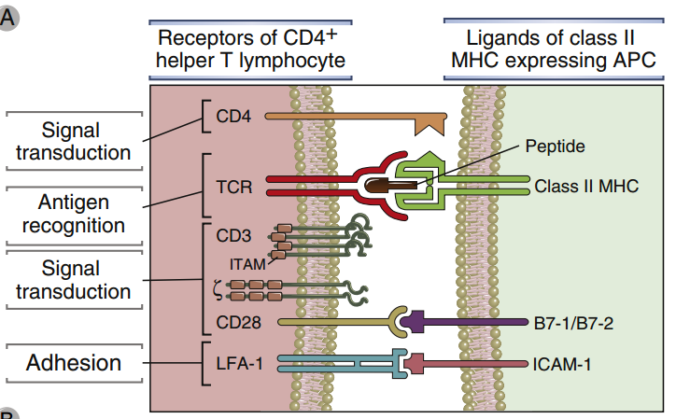
Interaction of the (TCR) with the peptide and (MHC)

Slide 18
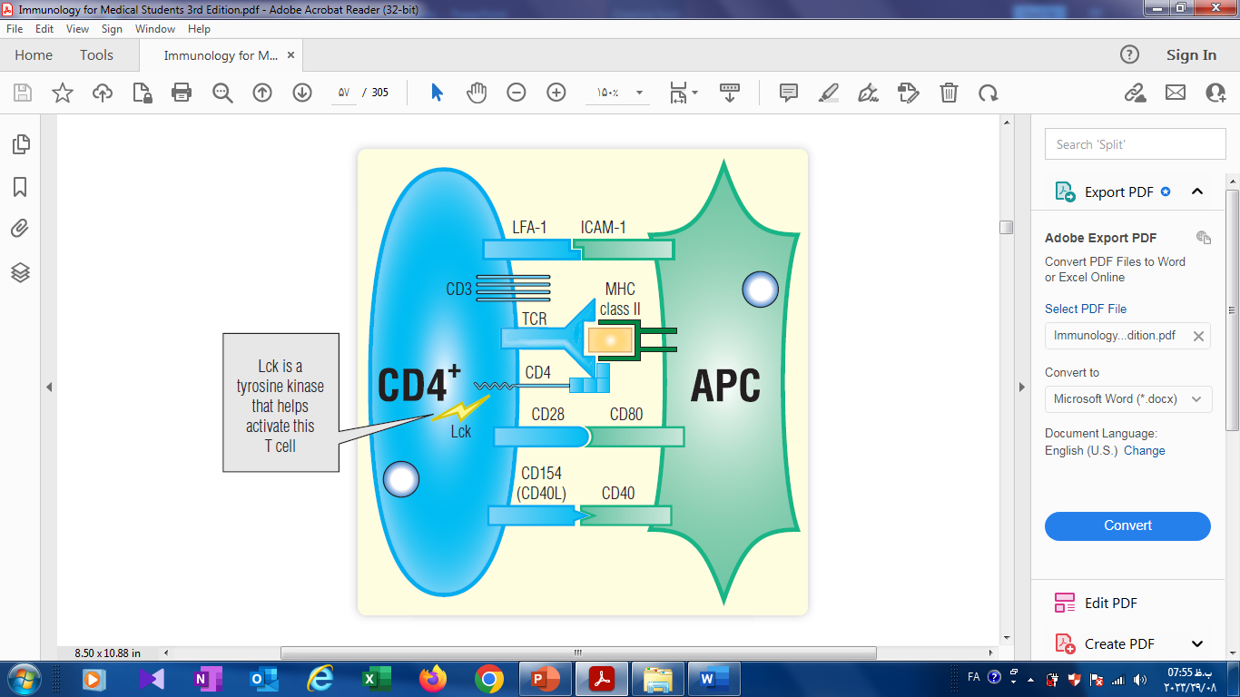
immunologic synapse between a CD4+ T cell and APC

Slide 19
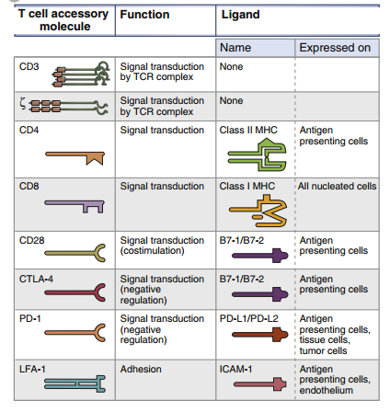

Slide 20
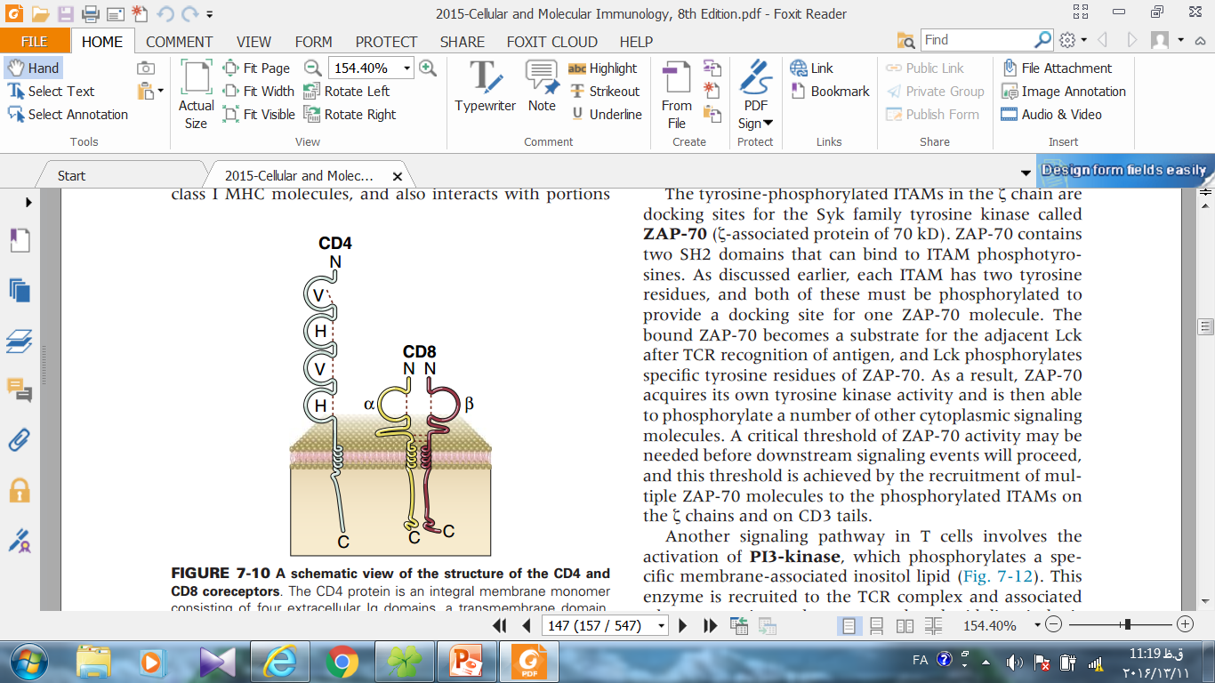
CD4 & CD8
T , Thymocyte
MNS , DC
HIV receptor
β2, α2 MHC-II
α3, MHC-I
38 aa
25 aa

Slide 21
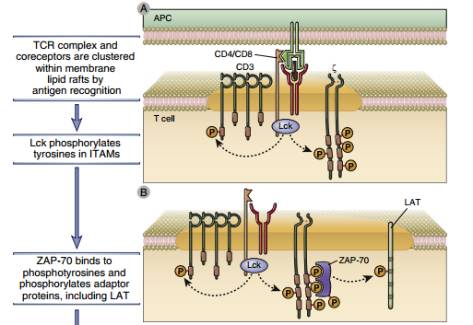
Recognition of Antigen
Optional

Slide 22
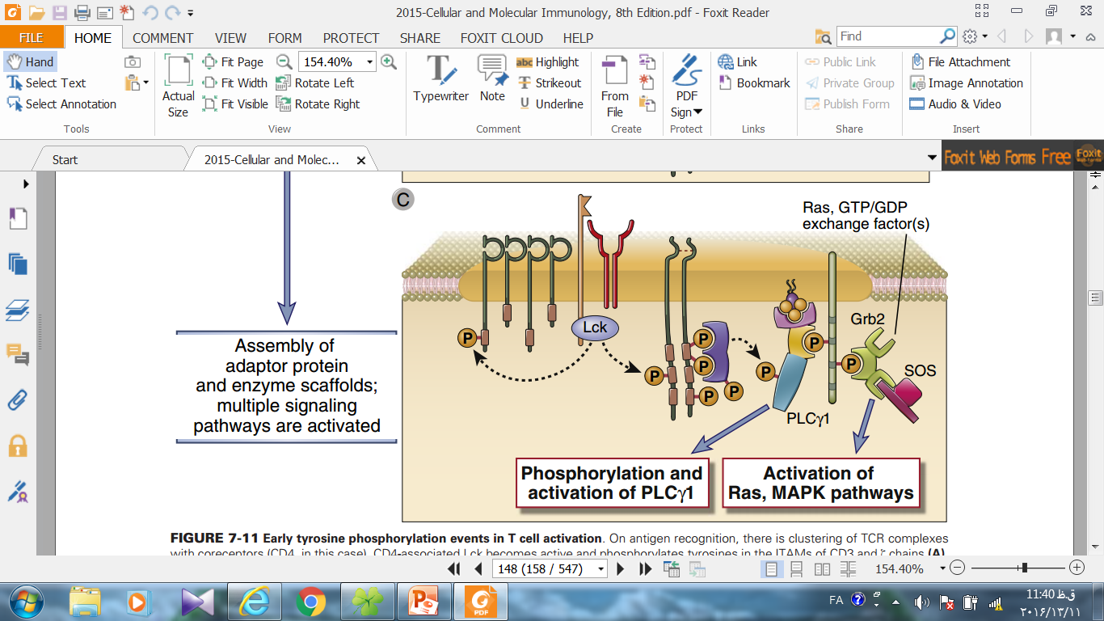
Recognition of Antigen
Optional

Slide 23
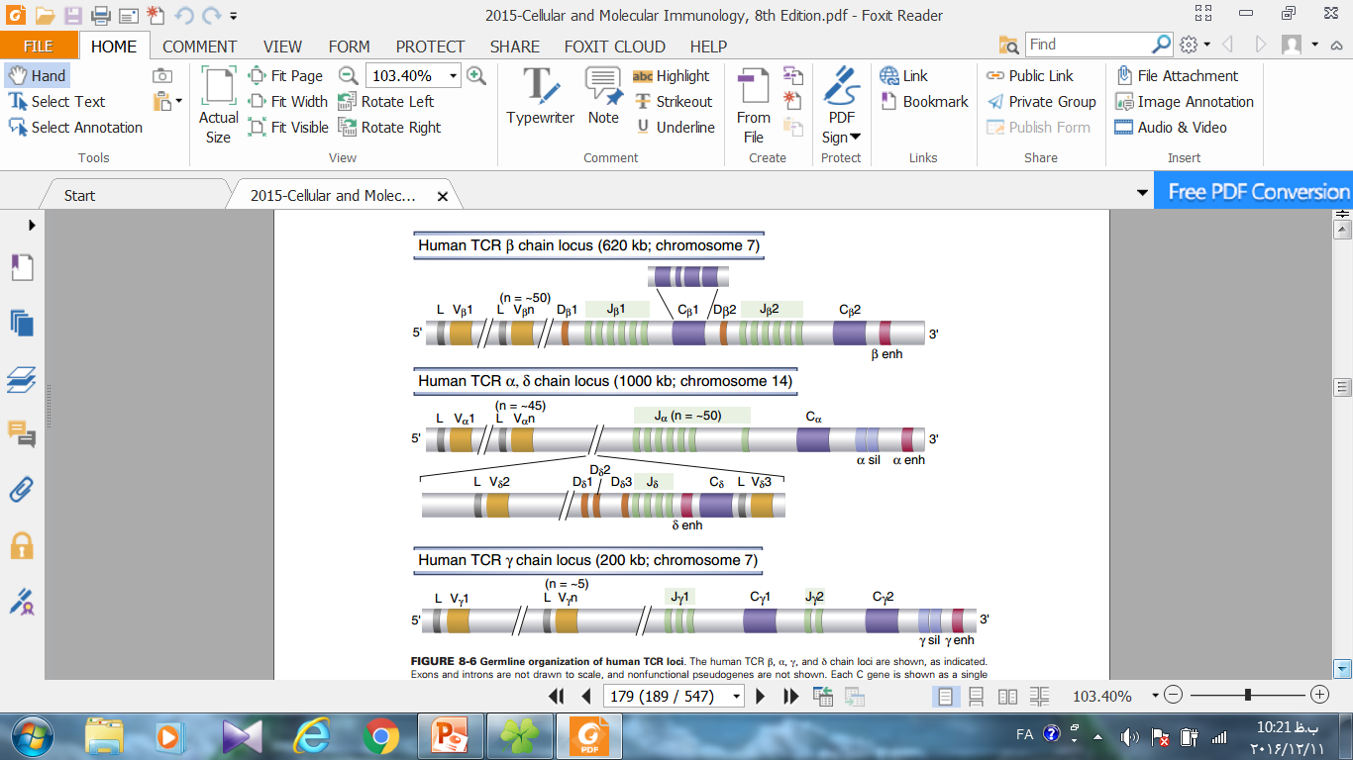
TCR Genetic
-80

Slide 24
TCR Genetic

Slide 25
TCR : Genetic & Structure

Slide 26
TCR : Genetic & Structure

Slide 27
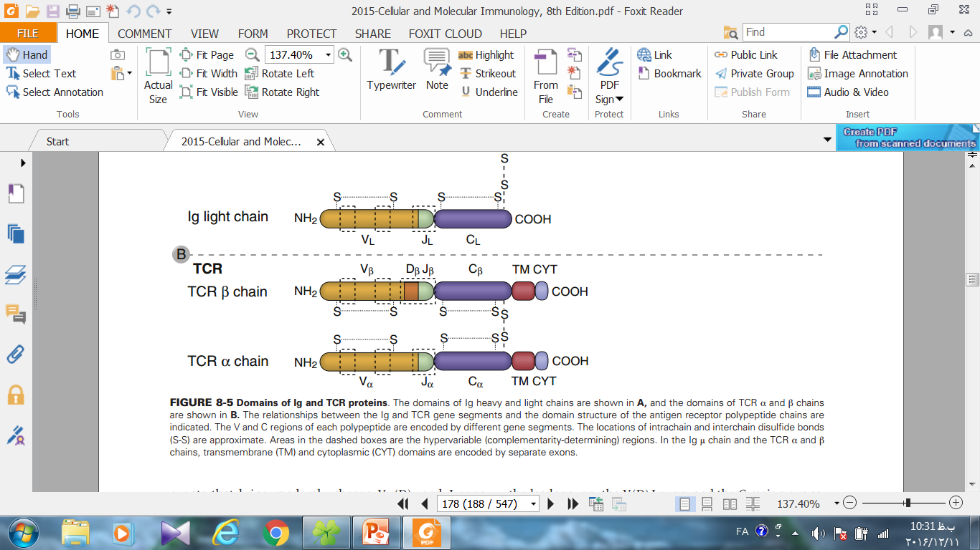
TCR Genetic
H-chain in Ab = β , δ in TCR
L-chain in Ab = α , γ in TCR

Slide 28
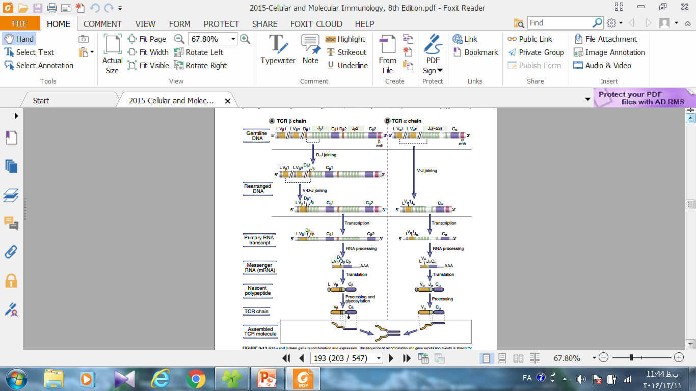
Gene Recombination in TCR
β & α chain
2
1

Slide 29
Gene Recombination in TCR
β & α chain

Slide 30
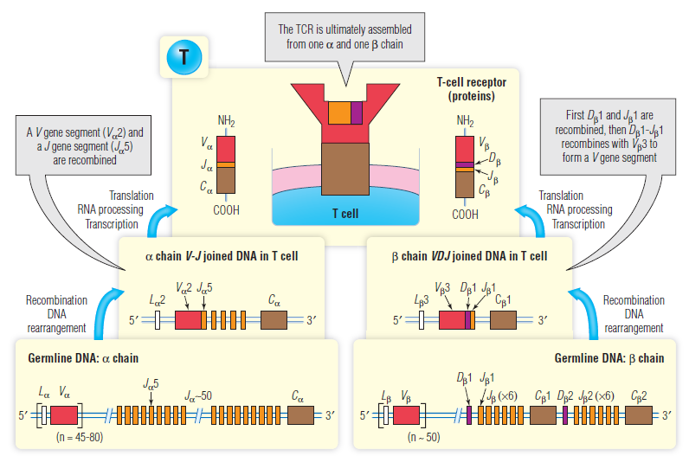
Synthesis and expression of a human αβ (TCR)

Slide 31

ازحضور وتوجه شما
سپاسگزارم

